Slide 1
Introduction to SQL
Avan Vora

Slide 2
Agenda – Day 1
Introduction
1
Why SQL?
2
Installation
3
SQL Queries
4

Slide 3





My Background
2012
2013
2014
2016
2017
2021
PRESENT
BE, Mechanical Engineering
University of Mumbai (India)
MS, Operations Research
Georgia Tech (USA)
Marketing Science Analyst,
in4mation insights
(USA)
Analytics Consultant, McKinsey & Company
(USA)
Senior Analytics Manager, Customer Analytics,
Wayfair
(USA)
Senior Lead, Product Analytics,
BrowserStack
(India)
Mentor
Mentored 250+ students

Slide 4
SQL is the industry standard for data manipulation and insight generation
Tech
E-commerce
Finance
Which features are customers using the most?
How to make more customers use our products?
Are reels more popular than posts?
Which items to store in which warehouses?
Which customers to send discount coupons to?
What are the biggest pain points of our customers?
To which customer should the credit card be offered?
What does the optimal allocation of a portfolio look like?
How do we identify fraudulent transactions?

Slide 5
MySQL Installation

Slide 6
Links
Windows: https://dev.mysql.com/downloads/windows/installer/8.0.html
Mac: MySQL - https://dev.mysql.com/downloads/mysql
Mac: SQL Workbench - https://dev.mysql.com/downloads/workbench/

Slide 7
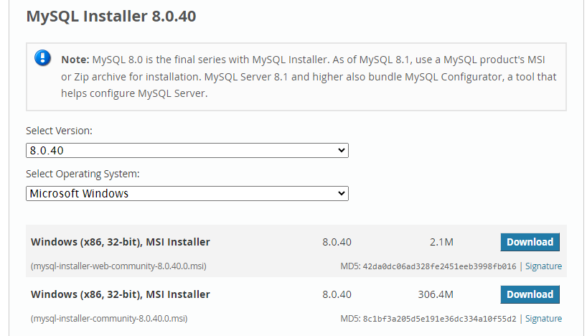

Slide 8
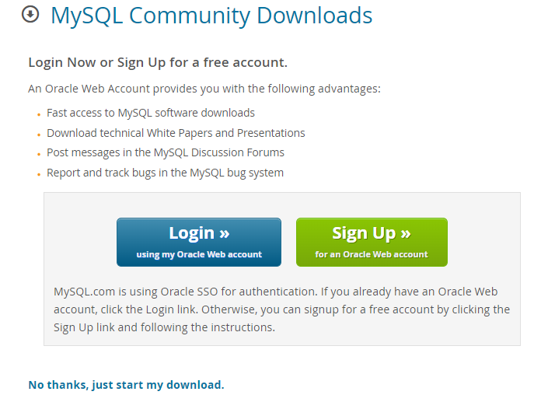

Slide 9
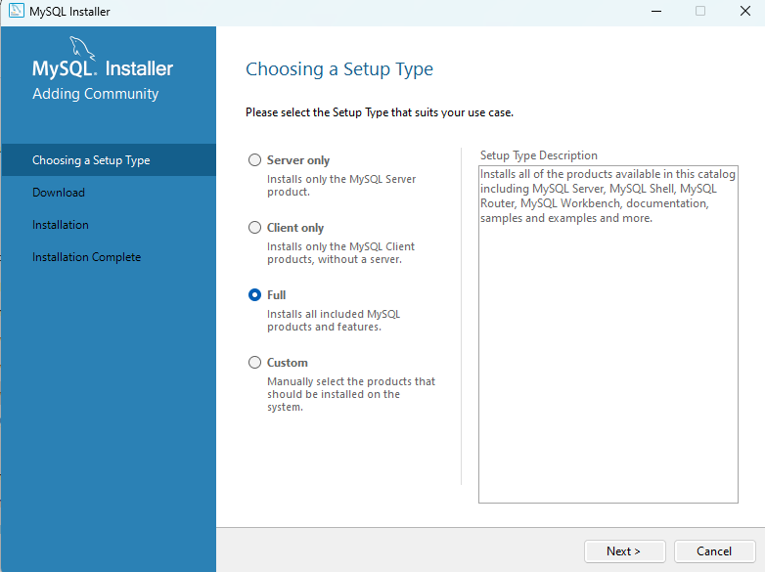

Slide 10
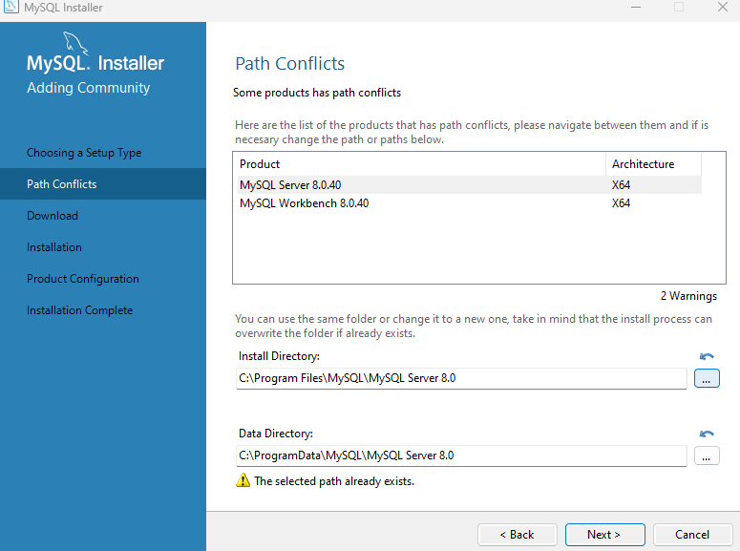

Slide 11
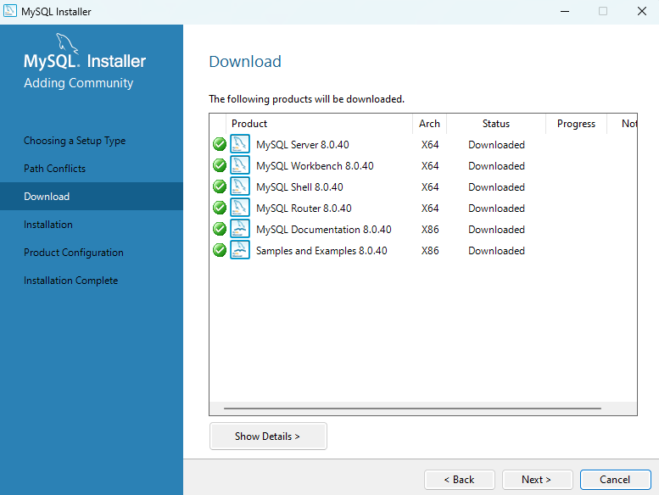

Slide 12
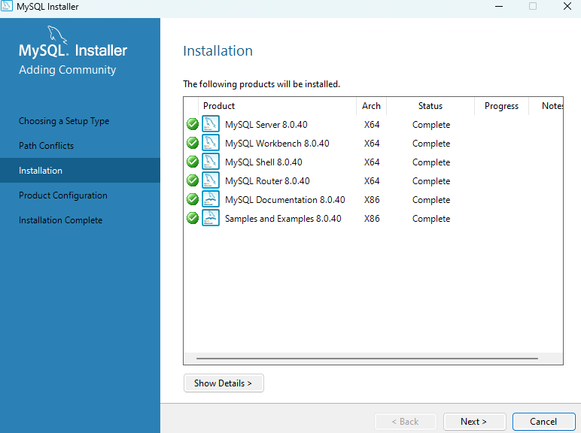

Slide 13
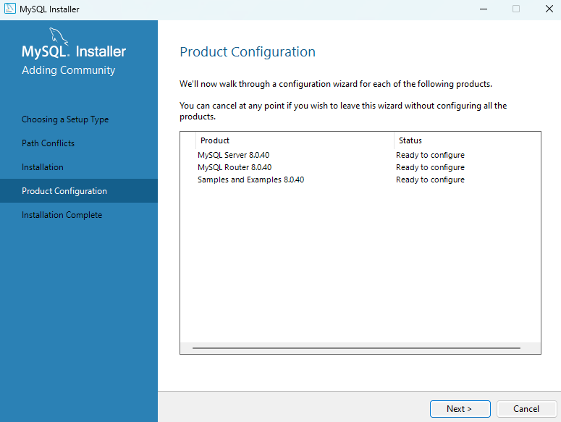

Slide 14
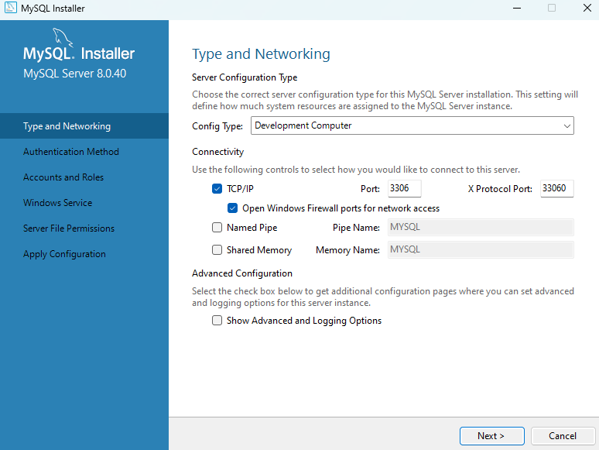

Slide 15
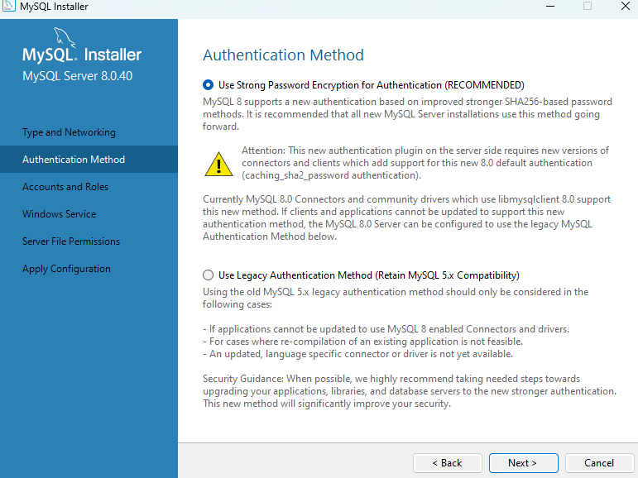

Slide 16
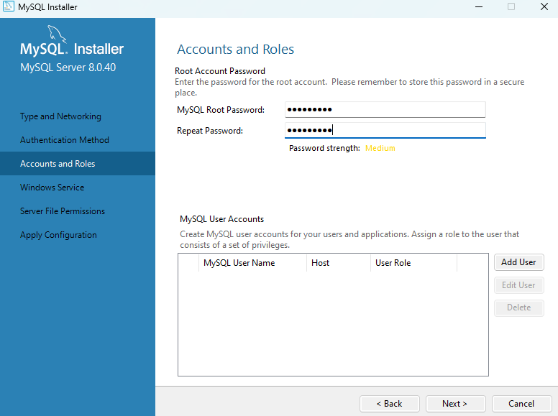

Slide 17
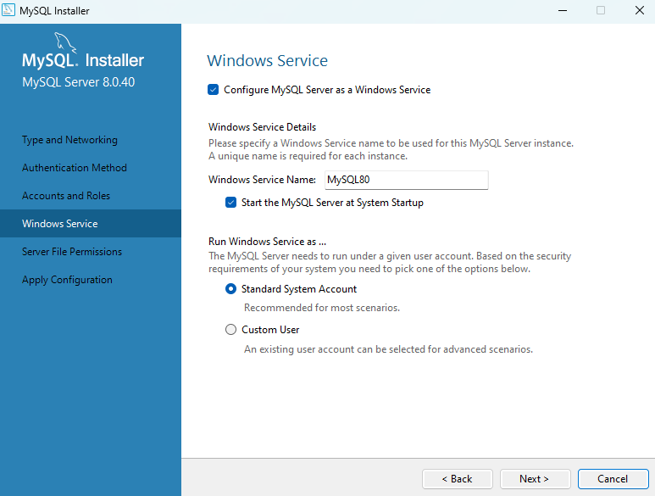

Slide 18
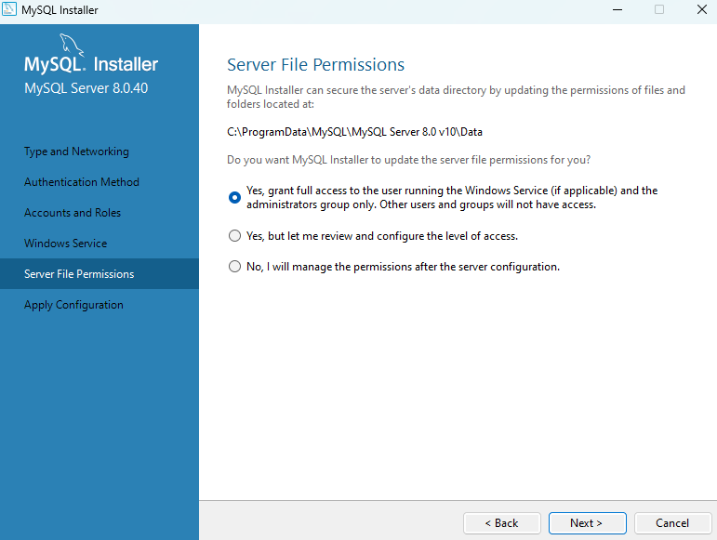

Slide 19
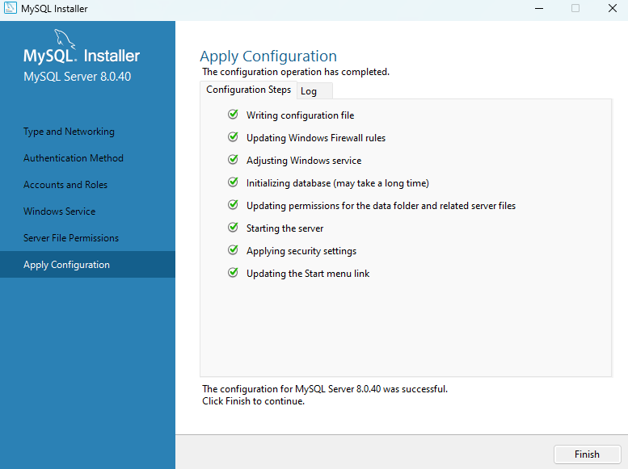

Slide 20
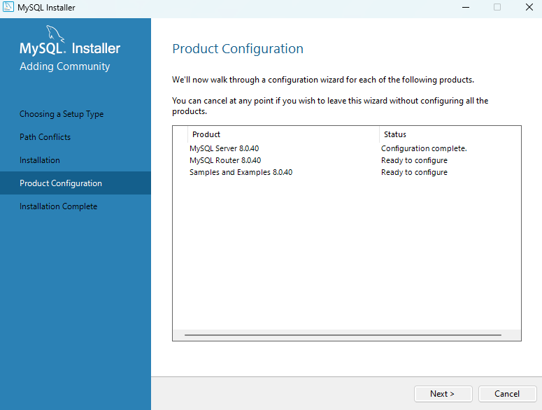

Slide 21
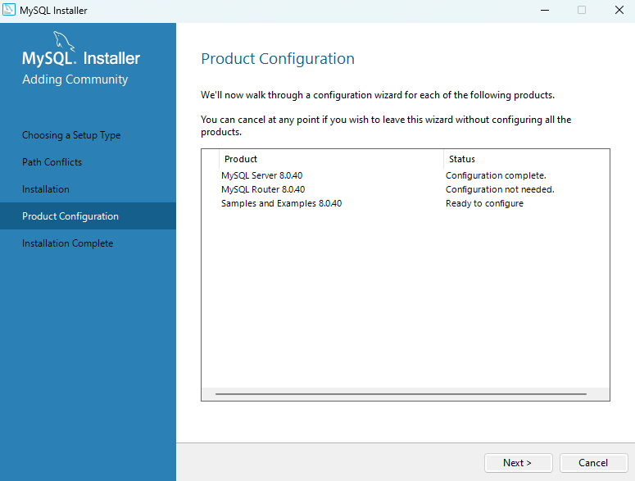

Slide 22
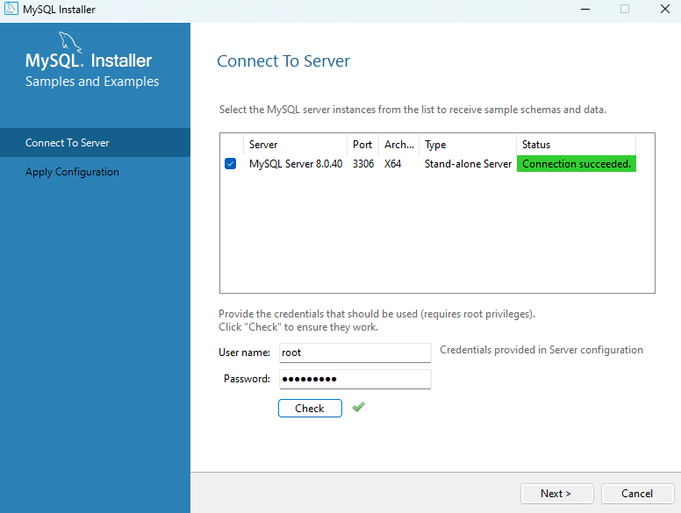

Slide 23
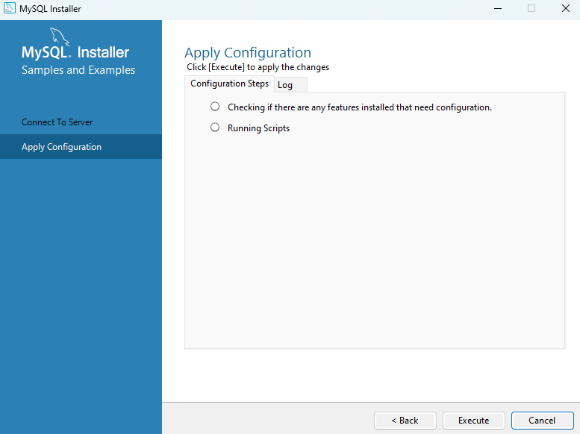

Slide 24
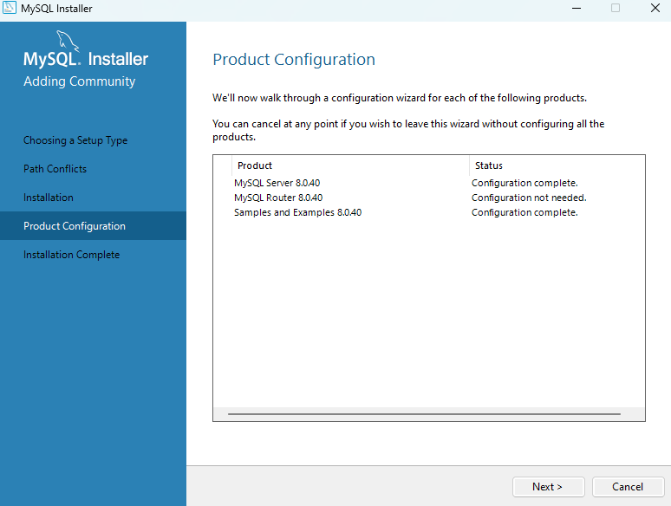

Slide 25
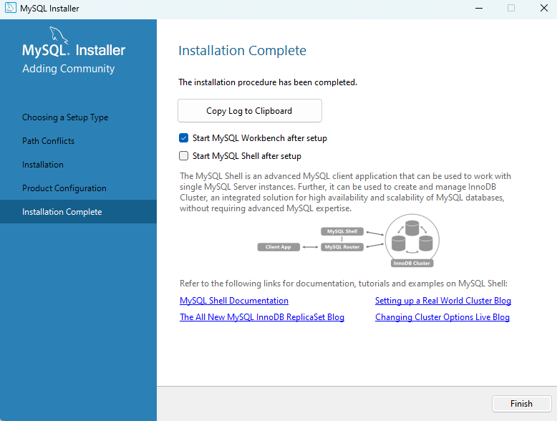

Slide 26
